Slide 1
Theorie Bioinformatica
Faster, better, stronger
Bioinformatics and functional genomics (3e) – Jonathan Pevsner (Wiley Blackwell)

Slide 2
De stof komt uit de college presentaties en Jonathan Pevsner "Bioinformatics and Functional Genomics"
(Wiley Blackwell; 3e editie) en een aantal extra papers
(deze worden expliciet in de betrokken colleges genoemd, en zijn te vinden onder "achtergrond").
College | Onderwerp | Hoofdstuk | Pagina's | Opmerkingen
1 | Recap Bioinf 1 | 3-4 | Zie Bioinf1 | Deze stof word t bekend verondersteld!
2 | Next Generation Sequencing | 9 | 377-423 | Niet de source code in je hoofd stampen!
3 | RNASeq | 11 | 479-515,519-528 | Niet de letterlijke R code, niet fig 11.17, 11.18, 11.19, 11.20
4 | Multiple Sequence Alignment | 6 | 205-217, 221-223 | Niet Box 6.3
8/9 | Assembly | 9/15 | 395-398,730-736 | Bestudeer ook de Powerpoint extra!
10 | The Burrough-Wheeler transform for mapping reads | 5
3 | Phylogeny | 7 | 245-289 | Niet Box 7.2,

Slide 3
Presentation content
Chapter 9: pg. 395-398
Chapter 15: pg. 730-736
http://pevsnerlab.kennedykrieger.org/php/powerpoints

Slide 4
Genome Assembly

Slide 5
Chapter 9: pg. 395-398

Slide 6
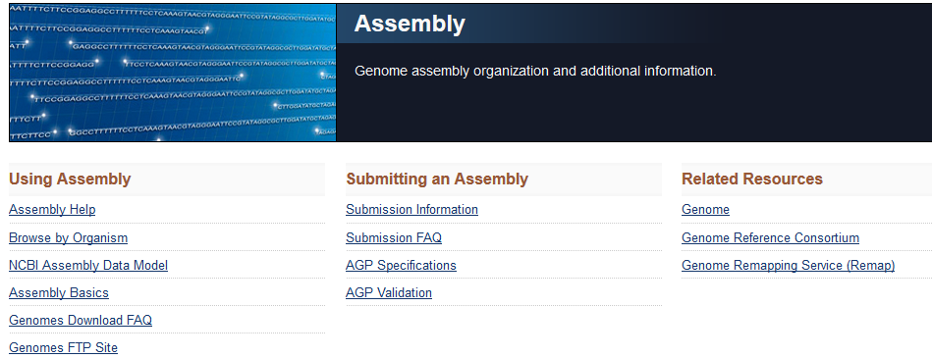
TOPIC 3. Genome Assembly
Genome assembly is the process of converting short reads into a detailed set of sequences corresponding to the chromosome(s) of an organism.
To learn more about assembly visit
http://www.ncbi.nlm.nih.gov/assembly/
http://www.ncbi.nlm.nih.gov/assembly/basics/

Slide 7
Genome assembly: relevance
Genome assembly is needed when a genome is first sequenced. We can relate reads to chromosomes.
For the human genome, the assembly is “frozen” as a snapshot every few years. The current assembly is GRCh38. (GRC refers to Genome Reference Consortium at http://www.ncbi.nlm.nih.gov/projects/genome/assembly/grc/)
For most human genome work we do not need to do “de novo” (from anew) assembly. Instead we map reads to a reference genome—one that is already assembled.
Genome assembly is a crucial behind-the-scenes part of calling human genome (or other) variants.

Slide 8
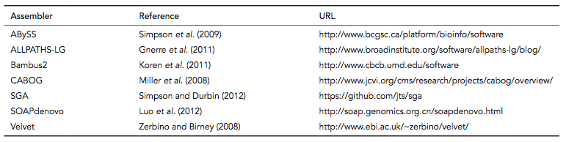
Software for genome assembly

Slide 9
Genome assembly methods:
overlap graph, de Bruijn graph, string graph
overlap graph
reads
Movie – de Bruijn graphs
de Bruijn graph
string graph

Slide 10
Genome assembly with overlap graph
and de Bruijn graph
DNA sequence with a triple repeat
Layout graph
Construction of de Bruijn
graph by gluing repeats
de Bruijn graph

Slide 11
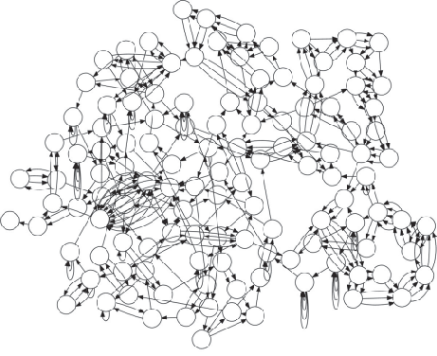
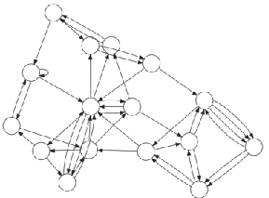

de Bruijn graphs resolve assembly with higher k values
E. coli K12 (k=50)
E. coli K12 (k=1,000)
E. coli K12 (k=5,000)
Source: PMID 24034426

Slide 12
Chapter 15: pg. 730-736

Slide 13
There are four main approaches to genome assembly.
Genome assembly
[1] Hierarchical assembly (or clone-based assembly) relies on mapping large-insert clones such as bacterial artificial chromosomes (BACs) or fosmids
[2] Whole-genome assembly (most common)
[3] Hybrid methods
[4] Comparative assembly

Slide 14
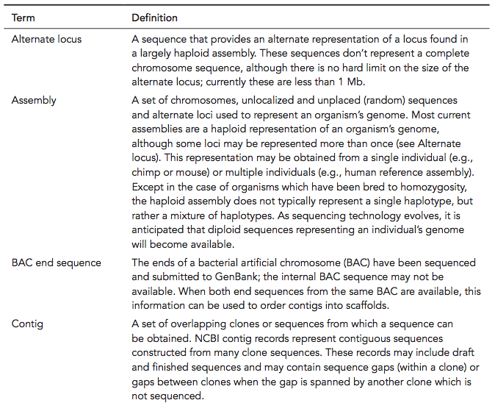
Terminology used in genome assembly

Slide 15
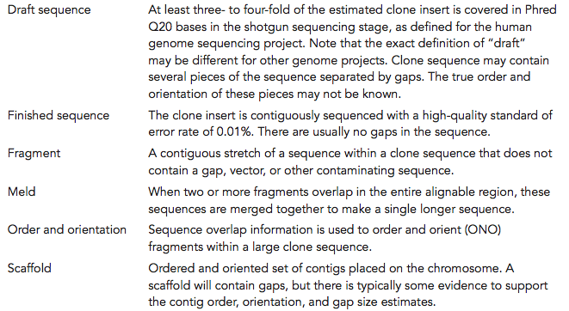
Terminology used in genome assembly

Slide 16
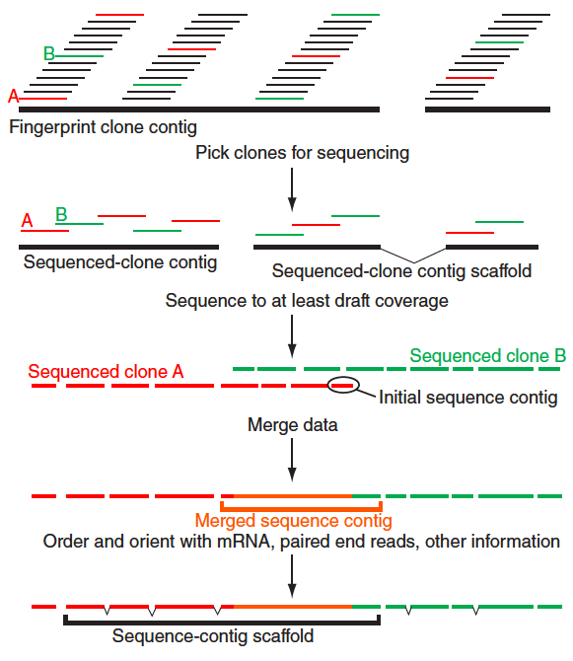
Assembly: hierarchical shotgun sequencing

Slide 17
Illustration of assembly using Velvet software
Analyze sequence data from a pathogenic E. coli strain.
We follow an excellent tutorial by Edwards and Holt (2013).
First obtain E. coli sequences for assembly.
Edwards, D.J., Holt, K.E. 2013. Beginner’s guide to comparative bacterial genome analysis using next-generation sequence data. Microbial Informatics and Experimentation 3(1), 2. PMID: 23575213.

Slide 18
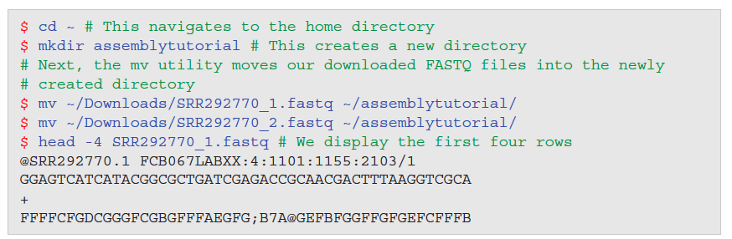
Assembly: download FASTQ files from ENA
Query the European Nucleotide Archive (ENA) for SRR292770, and download the FASTQ files to your laptop.

Slide 19
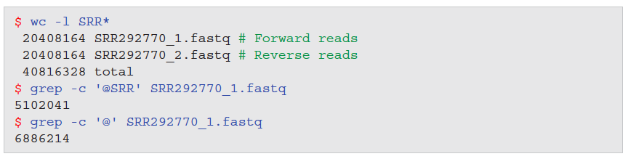
Assembly: count number of FASTQ files
Each FASTQ file has 20.4 million lines (rows), and the two files have exactly the same number of lines
The grep utility allows you to search for a string (such as “@SRR”) to count (-c) the number of entries (~5 million).
Be careful not to grep a symbol such as @ alone which is present in both the header and as a quality score symbol.

Slide 20
Perform assembly using Velvet software
Assemble reads into contigs.
Download, install Velvet
Compile using make
Specify that we want to create a hash table of the reads from the paired FASTQ files, using a k-mer length of 29
Output of velveth includes a Roadmap file and a Sequences file which are required for velvetg, a program that creates and manipulates a de Bruijn graph (Chapter 9).
Here -exp_cov is the expected coverage of unique regions

Slide 21
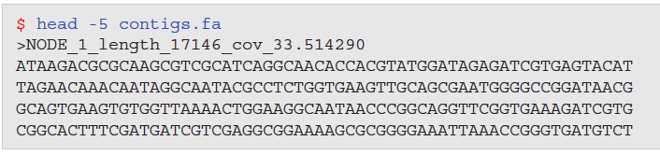
Perform assembly using Velvet software
The main output of Velvet is a set of contigs that have been assembled. Let’s look at the first five lines of the contigs.fa FASTA file; it contains sequences of the contigs that are longer than 2k (where k is the word length used in velveth).

Slide 22
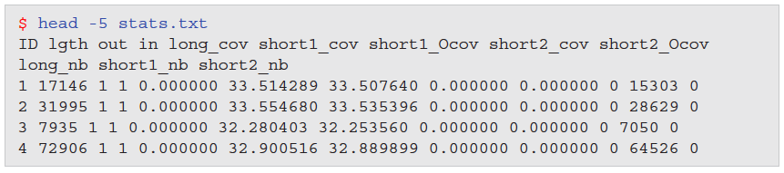
Perform assembly using Velvet software
Velvet creates a stats.txt file that specifies the nodes of the assembly.

Slide 23
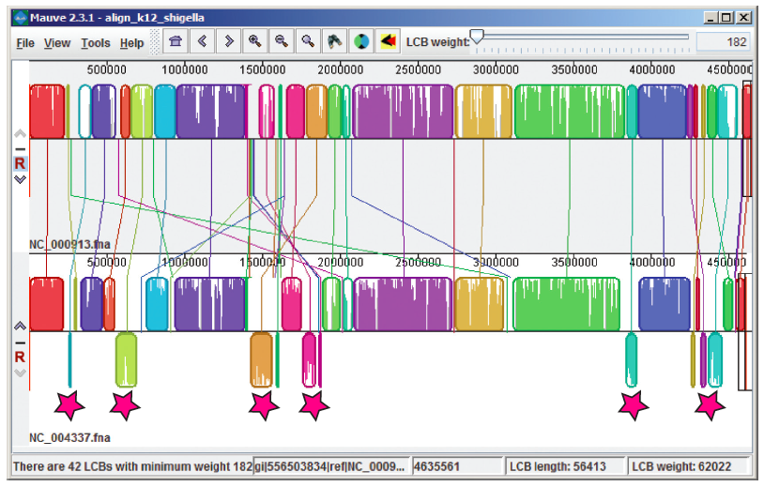
Genome comparisons with Mauve software
E. coli K12
Shigella flexneri
Mauve computes and visualizes multiple genome alignments. It searches for conserved segments between two genomes called “locally collinear blocks” (LCBs). Its strategy is anchored alignment (Chapter 6) using inexact, ungapped matches.

Slide 24
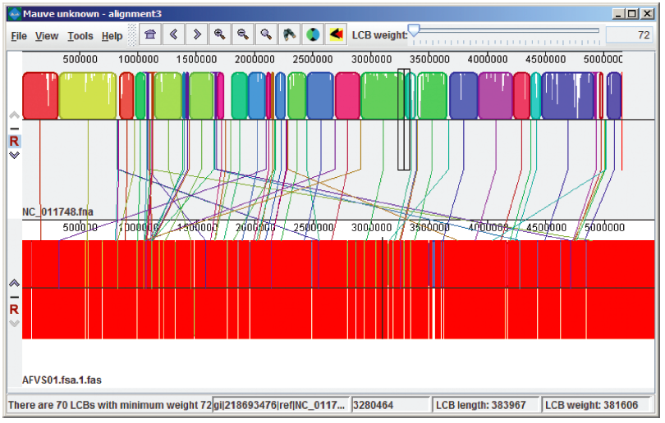
Genome comparisons with Mauve software
When genome sequences are assembled into contigs, these contigs can then be mapped to a completed reference genome. Here unordered contigs from E. coli O104:H4 are mapped to a completed E. coli Ec55989 genome.

